Slide 1
PREDICTION OF STOCK MOVEMENTS
USING LSTM NETWORK
UNDER THE GUIDANCE OF
Dr. J.P. Singh
NIT Patna
NAME: HRITHIK RAJ
COLLEGE: KIIT UNIVERSITY

Slide 2
Presentation Outline
Objective
Introduction
Data Collection`
Data labelling
Methods
Experiments And Results
Conclusion

Slide 3
Objective
To predict stock movements using LSTM network

Slide 4
INTRODUCTION
Stock market:-Process of predicting the future values of stocks.
Predictions helps any significant market to yield profit.
Many companies have developed stock predictors based on neural networks.

Slide 5
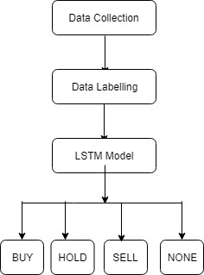
Proposed Model

Slide 6
Data Collection
Data-set:-Collected from moneycontrol.com using Octo-parse (Web Scrapping Tool).
Company's Stocks Name:- Airtel,PC jeweller,Bajaj Finance and Tata_Steel.
Features Extracted:-user_name,num_messages,stocks_predicted,user_level,followers,messages,time ,ratings and offensive.
Feature Used:- 'messages'.

Slide 7
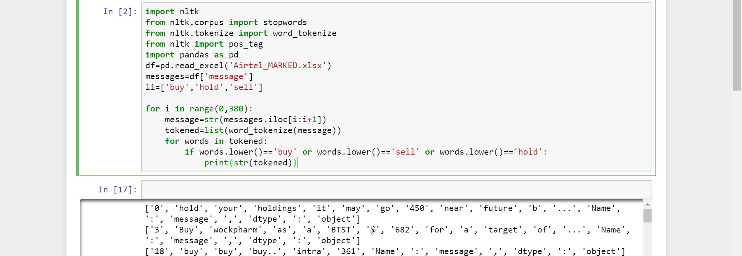
Data Labelling
Two ways of labeling:-
1.By coding in Python

Slide 8
Continued....
2.Manual labelling
By reading the messages which were left and noticing the target that has been posted by the particular user.
If the target given by the user is greater than the current price then-BUY and vice versa for SELL.
If the target given by the user is near about the current price in range(+ 5or -5) then HOLD.
If the message doesn't seems to give any sort of information then NONE.
Label Code word used for BUY-0,HOLD-1,NONE-2,SELL-3 as deep learning algorithm can only understand numbers.

Slide 9
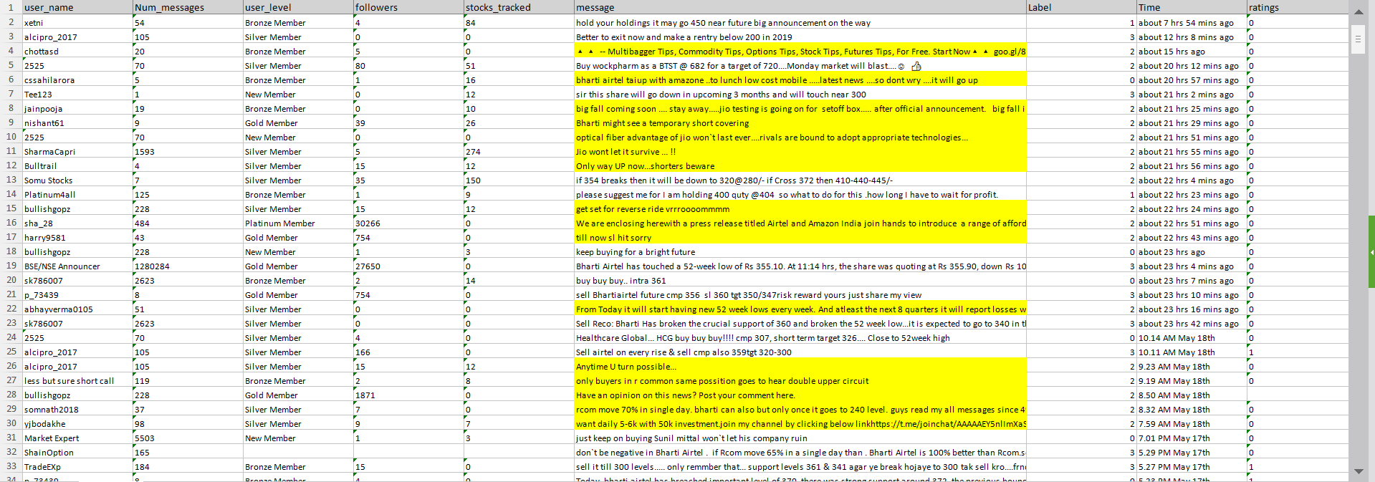
Overview of Data -Sample

Slide 10
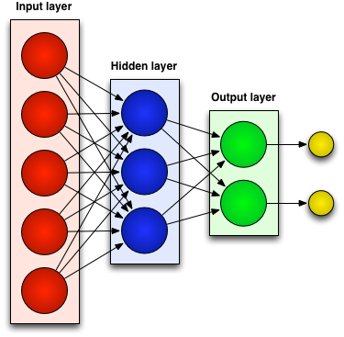
Methods
What exactly Deep Learning is?
->Deep Learning means using a neural network with several layers of nodes between input and output.
-> the series of layers between input & output do feature identification and processing in a series of stages, just as our brains seem to.

Slide 11
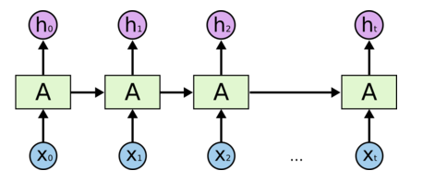
LONG SHORT-TERM MEMORY (LSTM)
An LSTM is a special kind of RNN architecture, capable of learning long-term dependencies.
Each memory cell contains four main elements:
Input gate
Forget gate
Output gate
Neuron with a self-recurrent
These gates allow the cells to keep and access information over long periods of time.

Slide 12
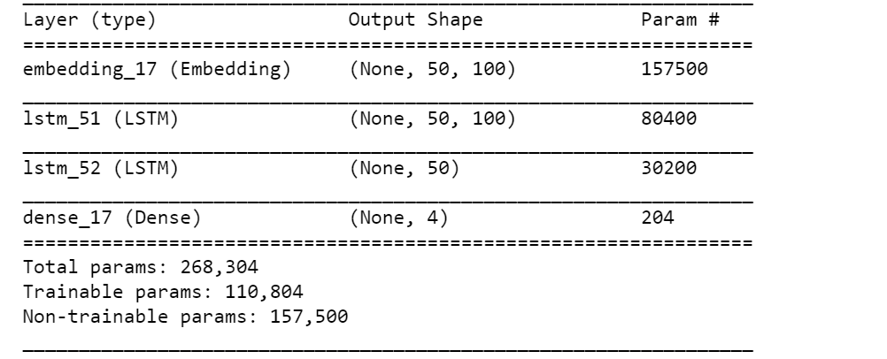
OVERVIEW OF MODELS

Slide 13
Structure Of RNN Model Created For This Project
Preparation of Text Data for Deep Learning with Keras
Tokenizer API
Encoding with one_hot
Sequence Padding
SMOTE
Embedding Layer
Activation Function('Softmax')
Loss Function( 'Categorical_crossentropy')
Optimizer Function('RMSprop')

Slide 14
EXPERIMENTS AND RESULTS
Language | Python 3.5
Framework | Keras
Windows | 10
Software | Jupyter Notebook
Type of Data | Activation Function &loss | Optimizer | Epochs | Batch_size | F1_score | Precision | Recall
Airtel(replicated) | softmax &categorical | RMS_prop | 75 | 20 | 0.82 | 0.84 | 0.85
Airtel(SMOTE) | softmax& categorical | RMS_prop | 50 | 16 | 0.66 | 0.66 | 0.66
Airtel (without SMOTE) | softmax & categorical | adam | 51 | 20 | 0.70 | 0.68 | 0.73
Airtel(replicated & with kfold=10) | softmax & categorical | RMS_prop | 50 | 20 | 0.95 | 0.97 | 0.95

Slide 15
CONCLUSION
In this project, we have built an algorithm for prediction of stock movements using LSTM model.
We have calculated performance metrics of the system using this model.
The experiment results show that precision, recall and f1-score values for SMOTE data with ‘Sofmax’ activation function and ‘Categorical’ cross entropy are 66%, 66% and 66% respectively.
Data without SMOTE ‘Softmax’ activation function and ‘Categorical’ cross entropy are 68%, 73% and 70% respectively. Our next step is to further increase the performance metrics of the system.

Slide 16
Thank You

